Slide 1




Sustainable Circular Farm to Fork Systems (SCFFS)
Joel Ikabat
Ana-Maria Radu
Roxana-Andreea Munteanu-Ichim
Maximilian Alexander Bootsveld

Slide 2
INTRODUCTION
How is food grown in your country ?
🌍 Europe
Food production is generally highly mechanized and technology-intensive, supported by advanced processing, cold chains and transport networks.
As a result, energy use, processing, transportation, consumption and food waste contribute significantly to the overall carbon footprint.
🌍 Africa
Food production relies more strongly on smallholder and rain-fed agriculture, with less developed storage and cold-chain infrastructure in many regions.
The carbon footprint is therefore more concentrated in agricultural production, land use and post-harvest food losses.
🌱 Different production systems and food supply chains lead to different carbon-footprint patterns.

Slide 3
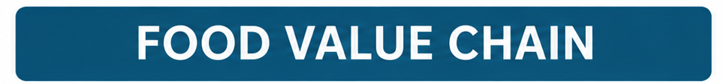
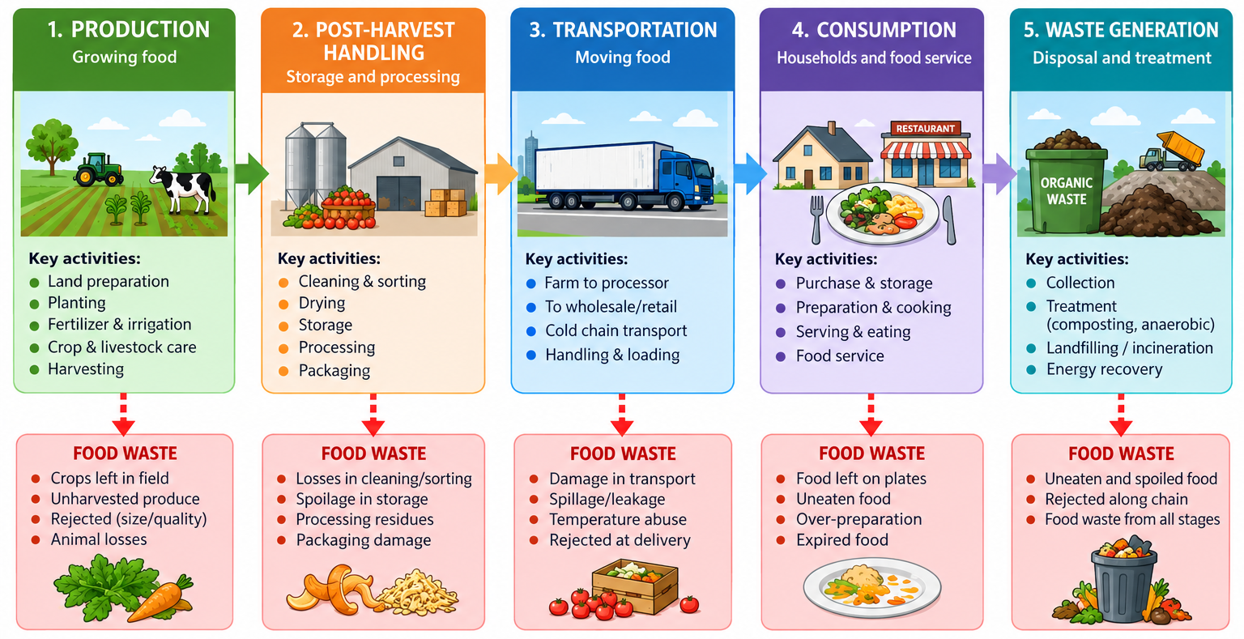

Slide 4
Carbon Footprint
Stage | Europe kg CO₂e per 100 kg CO₂e total | Africa kg CO₂e per 100 kg CO₂e total
Production | 50 | 75
Post-Harvest Handling | 18 | 11
Transportation | 7 | 4
Consumption | 15 | 3
Waste generation/end-of-life | 10 | 7
Total | 100 | 100

Slide 5
SCFFS as the Solution
Stage | Answer
Production | Precision Agriculture, Organic Farming, Crop Rotation
Post Harvest Handling | Cold Chains, Silos,
Transportation | Food Hubs
Consumption | Sustainable Packaging Material , Food Sharing, AI Driven Food Consumption Analytics
Waste Generation | Biotechnological transformation

Slide 6
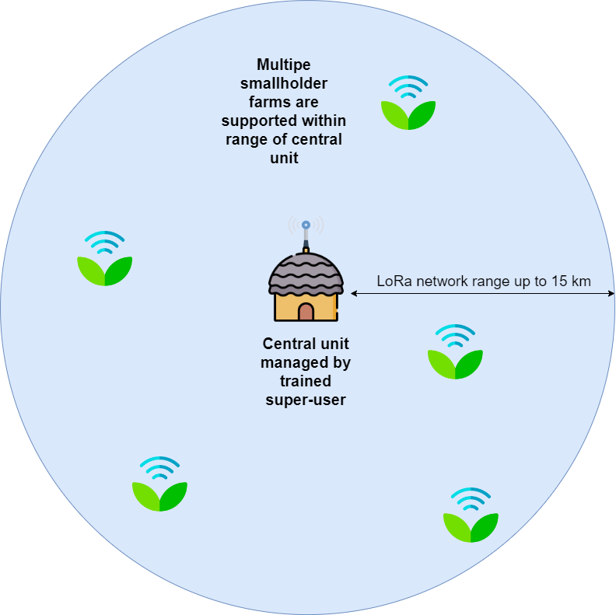
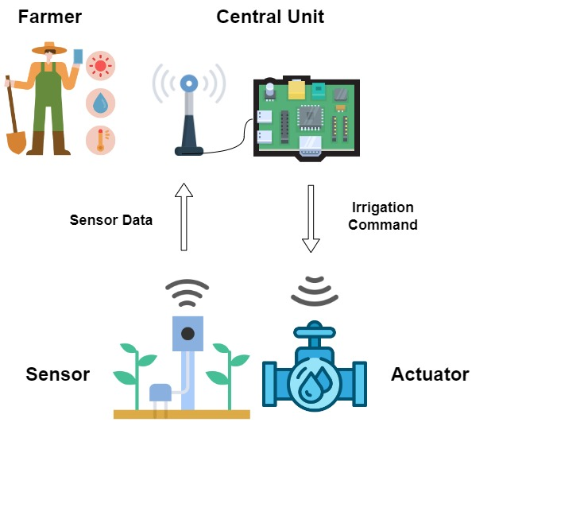
Production

Slide 7
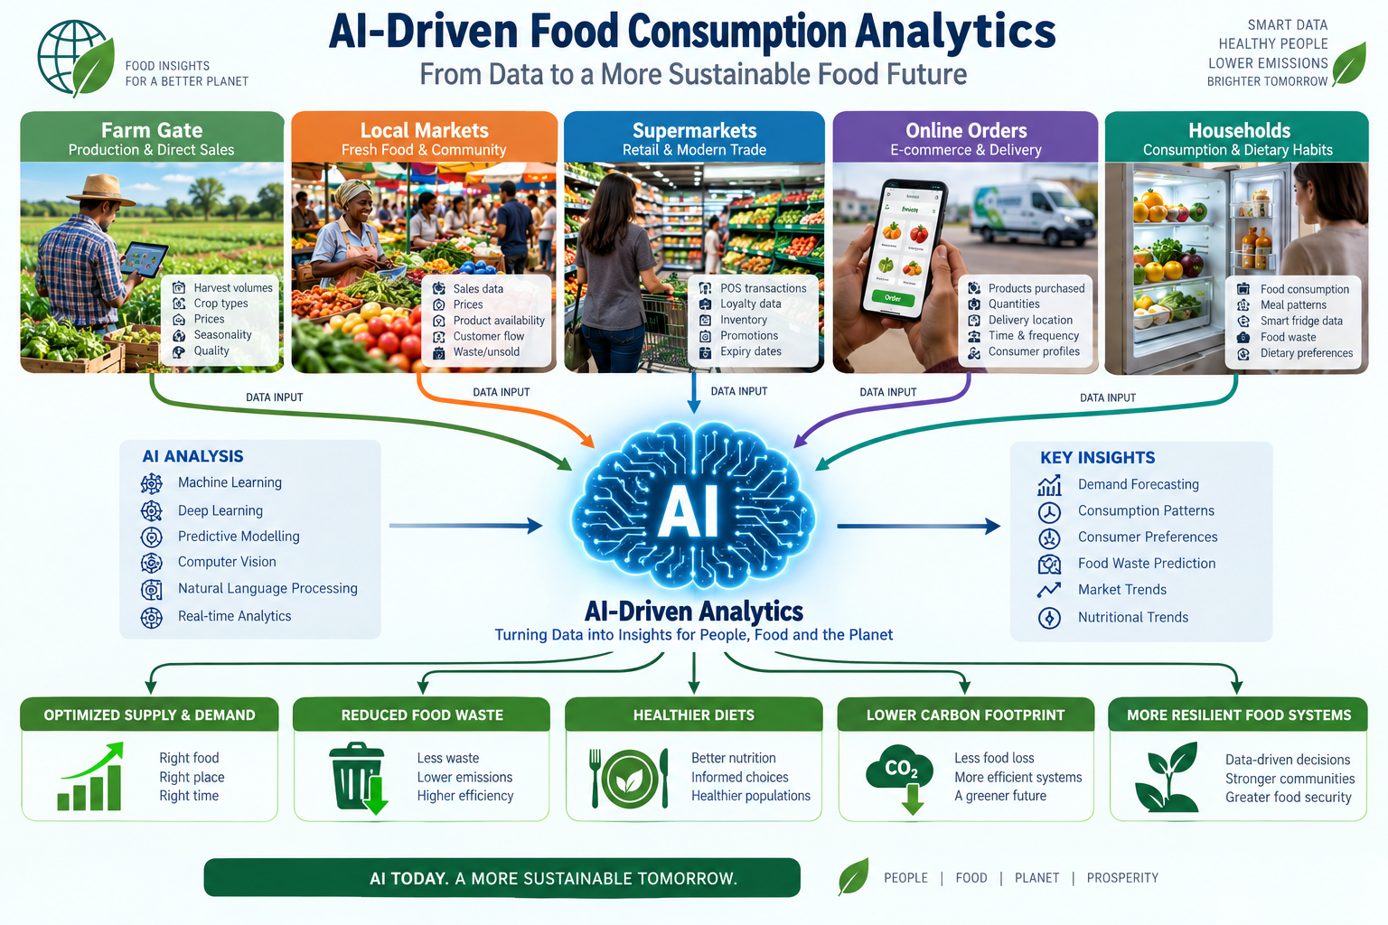
Consumption

Slide 8
WHEN WE WASTE FOOD, DO WE ONLY WASTE FOOD?
🍎 FOOD
But also…
💧 WATER used for production
🌱 LAND & SOIL RESOURCES used for cultivation
🧪 AGRICULTURAL INPUTS used to grow the crop
⚡ ENERGY used for processing, storage and transport
📦 PACKAGING & MATERIALS used before consumption
So the real question is not only:
“How can we produce more food?”
But also:
“How can we obtain more value from what we already produce?

Slide 9
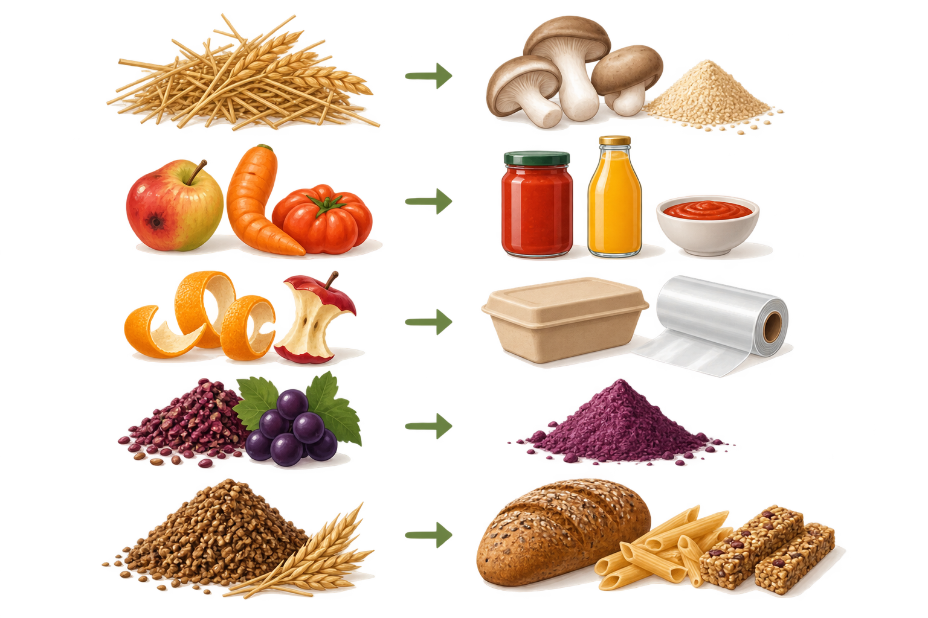
WHAT IF FOOD WASTE BECAME A RESOURCE?
🌾 AGRICULTURAL RESIDUES → MUSHROOMS 🍄 & YEAST 🟡
Straw and other crop residues can become growing substrates for edible mushrooms.
🍎 REJECTED PRODUCE → NEW FOODS 🥫
Fruits and vegetables that are still edible can be transformed into sauces, fermented foods, drinks or other products.
🍊 FRUIT SIDE-STREAMS → BIO-BASED PACKAGING 📦
Peels and pomace contain useful compounds such as pectin and cellulose that can be used to develop food films and coatings.
🍇 GRAPE POMACE → FOOD INGREDIENTS 🧪
Grape skins and seeds left after processing can provide fibre and valuable bioactive compounds for new food products.
🌾 BREWERS’ SPENT GRAIN → NEW FOODS 🍞
The grain left after brewing is rich in fibre and protein and can be reused as an ingredient in bread, pasta or snacks.
WASTE → RESOURCE → NEW VALUE ♻️
Keeping valuable agricultural resources within the food system

Slide 10
Conclusions
🌍 One planet, many paths
Europe and Africa waste food at different points, for different reasons — sustainability isn't a single fix, it's a fit.
♻️ The common path
Sustainability is not only about producing more — it is about using better, wasting less and recovering more value.
🔄 Circularity is the system, not an add-on
Production, biotechnology, and engineering aren't separate stages — they're one continuous loop, and every closed loop is carbon we didn't have to spend twice.
The most sustainable meal isn't the one grown fastest — it's the one nothing is wasted from.
🌱 SCFFS: from farm to fork, and back again — nothing lost, everything valued.

Slide 11
